Slide 1
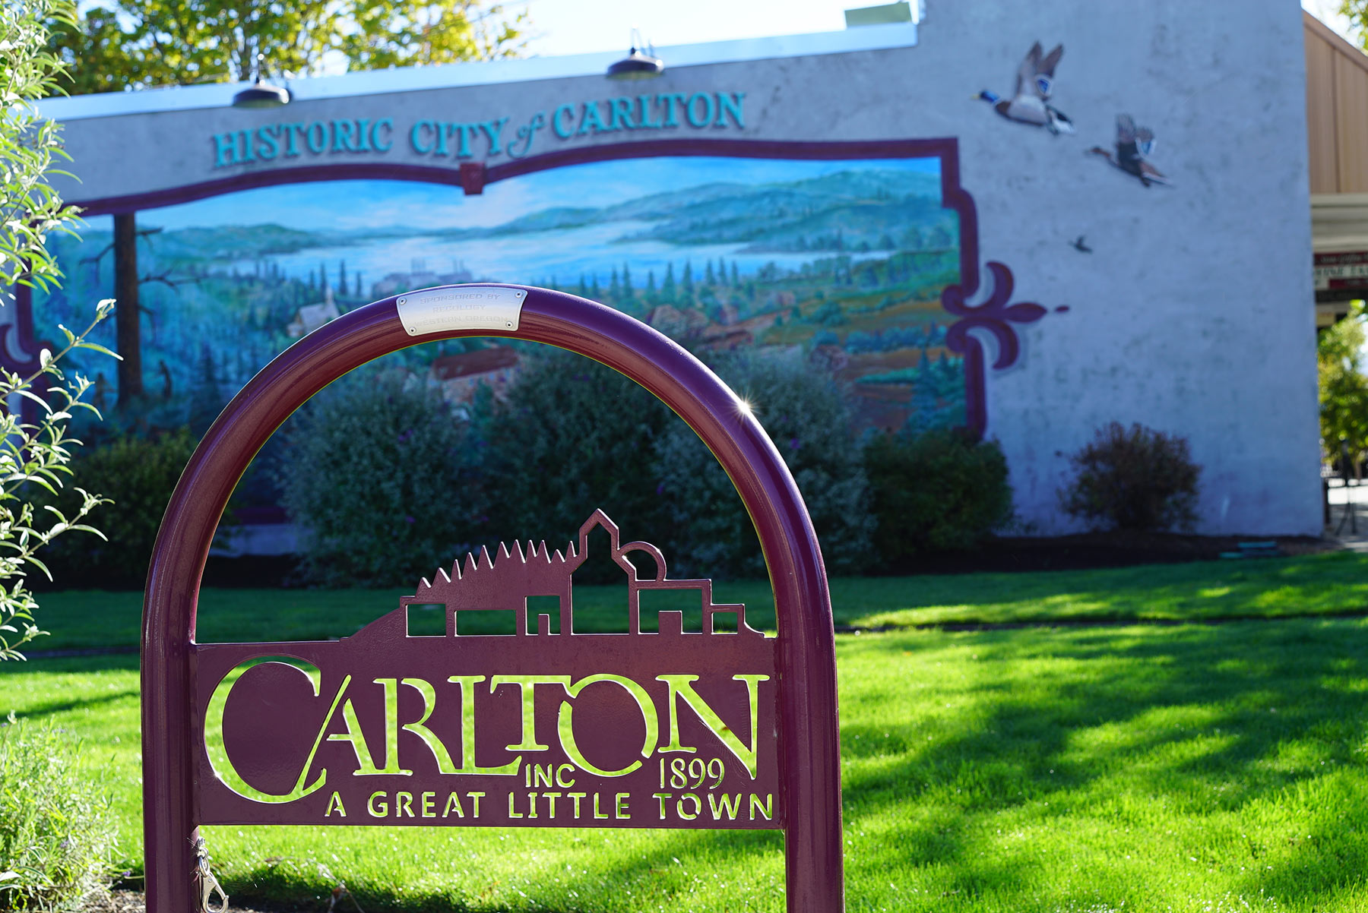
Envision Carlton Summit #1
June 1, 2022, 6pm
Carlton Vision and Comprehensive Plan
Notes:
Welcome!
Introductions-
Your team!

Slide 2
Agenda
Welcome
Project Overview
Community Outreach Summary
Draft Vision (Discussion)
Vision Statements (Activity)
Next Steps
Adjourn

Slide 3
Project Overview

Slide 4
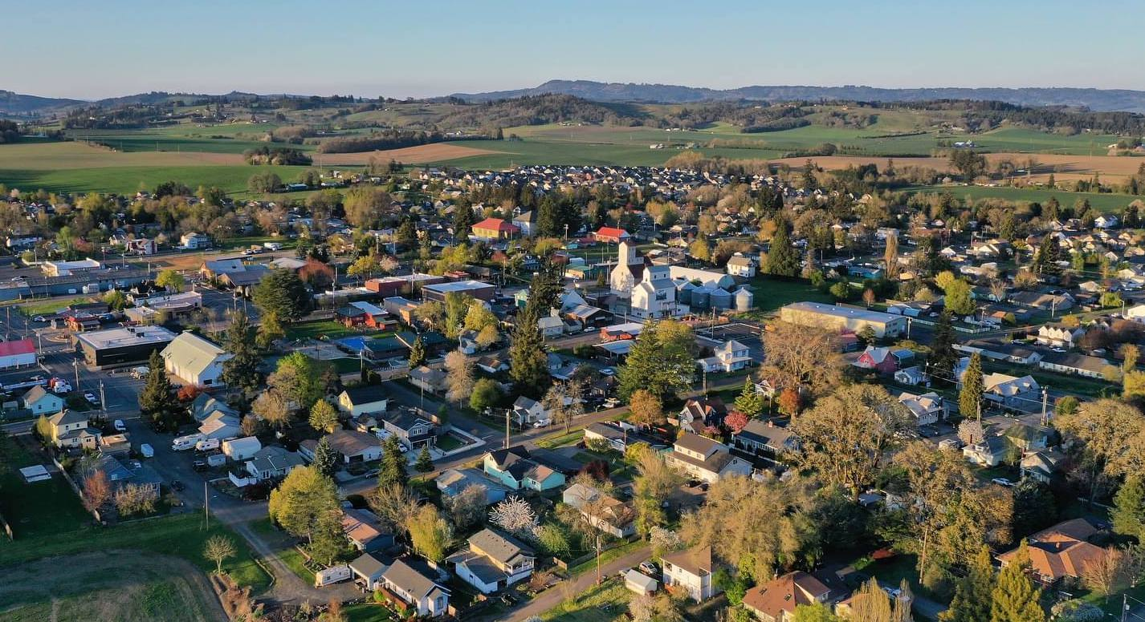
What is a Vision and
Comprehensive Plan?
Notes:
What is a Vision? What is a Comprehensive Plan?
The Comprehensive Plan is a planning document that directs all activities related to land use and the future of natural and man-made systems and services in Carlton. The plan helps manage expected population and employment growth through a set of goals, policies, and implementation measures that align with the community’s vision.
All Oregon cities and counties are required to have a comprehensive plan that is consistent with 19 Statewide Planning Goals established by the Legislature. These goals set broad statewide policy goals for land use planning, citizen involvement, housing supply, economic development, transportation systems, recreation and more. They also direct the content within comprehensive plans. Under State law, all area and community plans, zoning codes, permits, and public improvements must be consistent with the comprehensive plan. This structure ensures that cities implement the State’s policy goals first through the comprehensive plan, and then by more detailed supporting and implementing documents, such as development codes and community plans, which are in turn consistent with the Comprehensive Plan.
City leaders use the Comprehensive Plan to coordinate public investments and to make decisions about new development, existing neighborhoods, transportation, and a variety of other topics.
The Vision is a statement of what community members want Carlton to be in 20 years. The Vision statement expresses the values and aspirations of community members and guides the development of goals and policies. Oregon was one of the first places in the United States to pioneer the use of community-based visioning. In a state recognized for innovative local planning and growth management policies, visioning is an important precursor to local planning and a tool to help communities better manage complex change. A comprehensive approach to visioning can be framed by asking the questions in the Vision survey and the Community Conversations Kit, which I will explain later in the meeting.

Slide 5
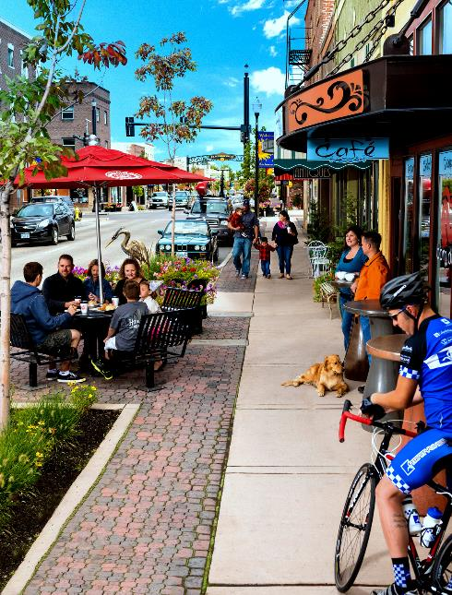
Vision and Comprehensive Plan Process
Background Report
Where are we now?
2040 Vision
Where do we want to go?

Slide 6
Vision and Comprehensive Plan Process
Background Report
Goals and Policies
Where are we now?
2040 Vision
How do we get there?
Where do we want to go?

Slide 7
Vision and Comprehensive Plan Process
Background Report
Goals and Policies
Comprehensive Plan
Where are we now?
2040 Vision
How do we get there?
Vision
Background Reports
Where do we want to go?
Goals
Policies

Slide 8
Project Schedule

Slide 9
Community Outreach Summary
Notes:
Hello everyone, I have been working alongside Steve to manage and summarize the engagement efforts to date. I will go over the two main forums used thus far to obtain community input.

Slide 10
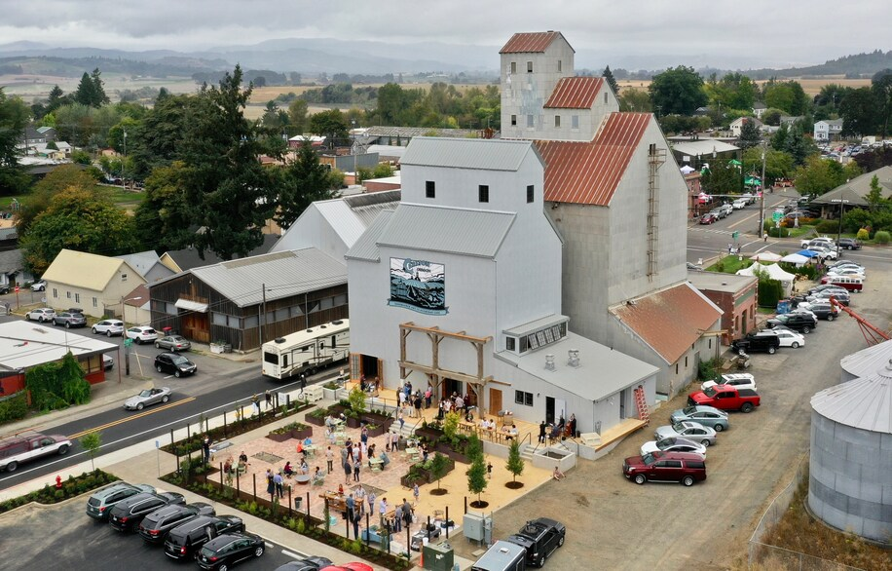
What makes Carlton special today?
What would you like to change in the future?
10 Community Conversations with local groups and organizations
154 online questionnaire responses as of May 17

Slide 11
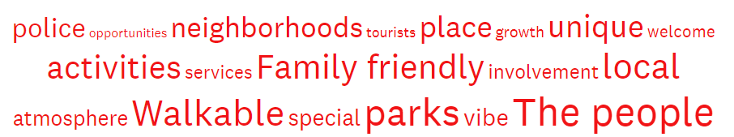
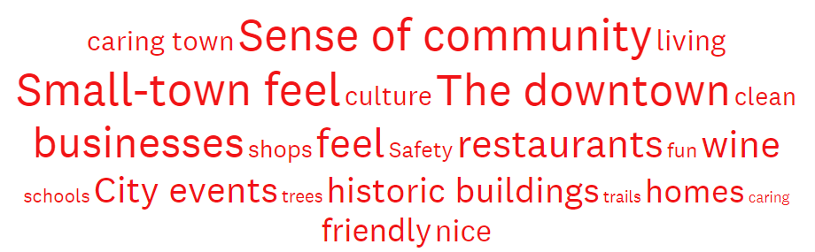

Online Survey
Community Engagement Summary
Notes:
This word cloud was created from the most frequently repeated words in the responses given to the question, “What makes Carlton special today? What should we strive to preserve or enhance?” Among survey and community conversation participants, there are several dominant themes that emerged regarding what they liked about Carlton. The small-town atmosphere and its associated caring community, the charm of downtown and local businesses, and the historical buildings are all commonly enjoyed aspects of Carlton.

Slide 12
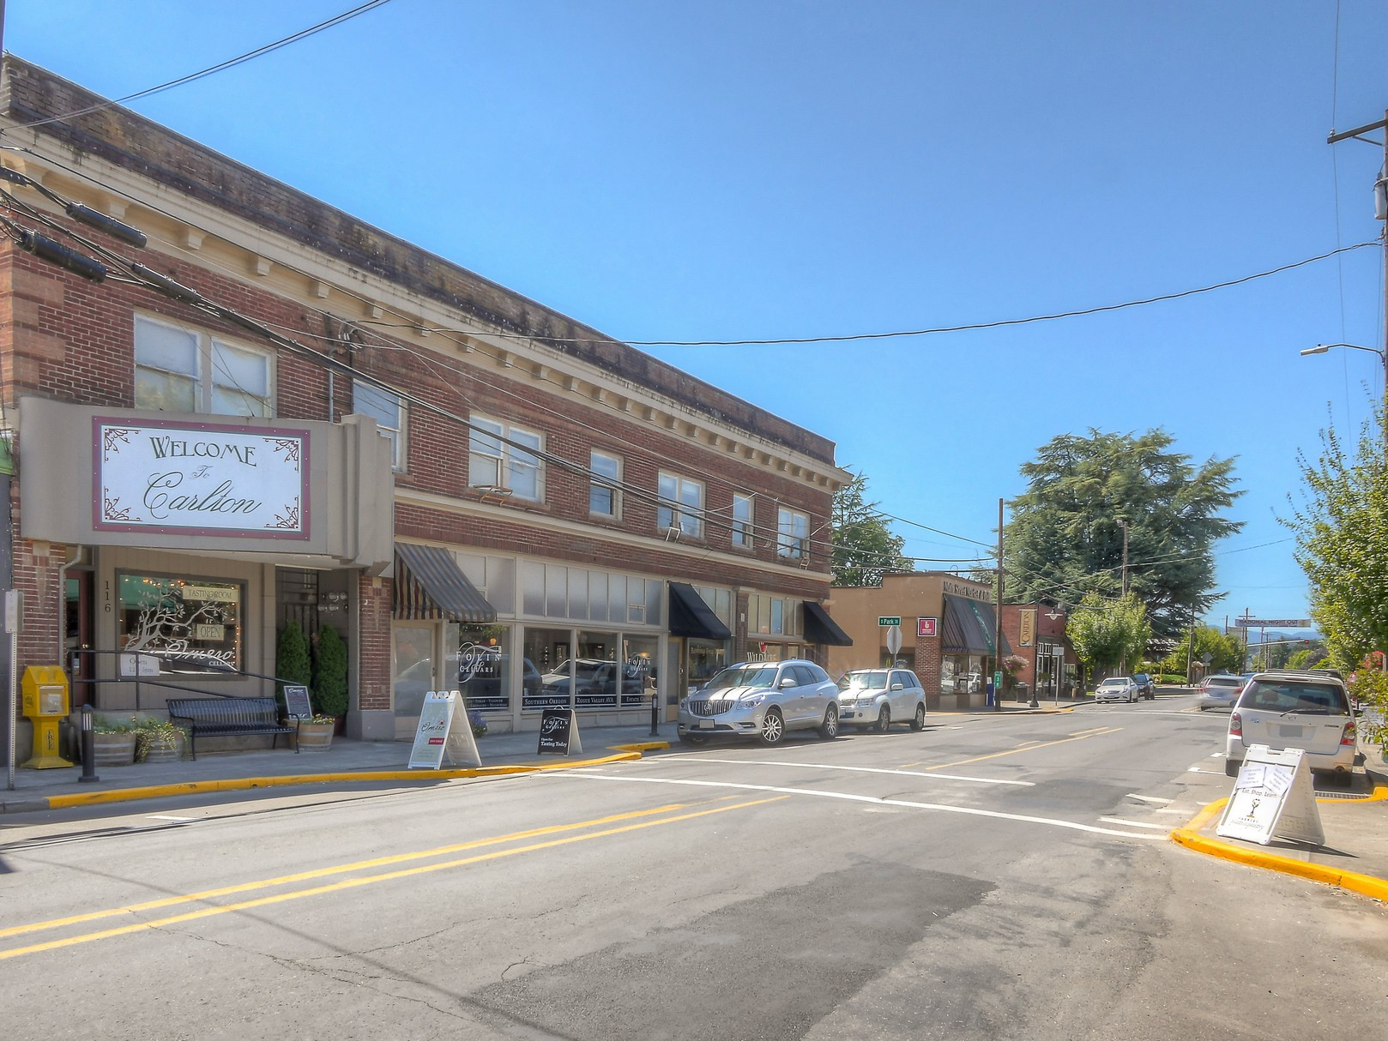
Community Conversations
“What makes Carlton special is its sense of community and togetherness. It's a quaint "small town" We need to preserve this because not only do I feel like people move here to experience this, but tourists like that too. They like to go to "cute, small " towns as an experience. A good walking footprint is important too.”
“Love the downtown area and the charm and feel of the older established buildings. New commercial and business growth should take the atmosphere and feel into consideration when new construction and growth are approved...”
Community Engagement Summary
Notes:
Included here, are some quotes from the engagement process which helped to form the Key Findings.

Slide 13
Key Findings
Preserve the small-town atmosphere – Specifically the community, safety, and family-friendly opportunities.
Facilitate community togetherness – Through events and activities, walkability, and investment in schools.
Support and expand businesses – The downtown area and its businesses are thoroughly loved, with the hope for expansion of business types (i.e., grocery store, pharmacy, retail).
Promote enhancements to infrastructure – With a specific focus on pedestrian amenities, rerouting Highway 47 to reduce traffic, and associated physical hardscape improvements.
Conserve historic features and culture – Preserving historical buildings and features in town, through architectural guidance and overall downtown aesthetic.
Community Engagement Summary
Notes:
The following “themes” emerged from community outreach activities, and each is accompanied by a comment that exemplifies the theme. Each theme is meant to encompass either a finding related to how respondents feel about Carlton today, and what they would like to see preserved or changed in the future.

Slide 14
What do you love about Carlton today?
Small town atmosphere
Caring community, safe, family-friendly
Downtown charm and local businesses
Historic buildings
Proximity of Carlton to McMinnville
Parks – Wennerberg Park, pool
Walkability
Rural/country/agricultural aesthetic
Community Engagement Summary
Notes:
From the survey data, we pulled these following statements highlighting what people love about Carlton.

Slide 15
What would you like to change in the future?
Infrastructure and maintenance improvements – bike lanes, walking paths, streetscape, school improvements
Improved traffic conditions
Community center or town hall
More diverse business types – grocery store with fresh produce
More recreation options – parks, trails, gathering places
Concern about growing unaffordability for housing and water
Community Engagement Summary
Notes:
From the survey data, we pulled these following statements highlighting what people would like to see change in Carlton.

Slide 16
Draft Vision Statement

Slide 17
Vision Statement
The “what,” i.e. basic direction

Slide 18
Vision Statement
The “what,” i.e. basic direction
Goals Statements
The “where to,” i.e. what we must achieve to get there

Slide 19
Vision Statement
The “what,” i.e. basic direction
Goals Statements
The “where to,” i.e. what we must achieve to get there
Policy Direction
The “how,” i.e. specific outcomes

Slide 20




In 2042, Carlton is “A Great Little Town” with:
Rural Heritage and Small-town Character
Prosperous Economy
Family-Friendly Neighborhoods
Well-Planned Infrastructure
Vision Statement

Slide 21
In 2042, Carlton is “A Great Little Town” with:
Rural Heritage and Small Town Character
Agricultural legacy and rural setting
Safe, quiet, and quaint
Community events and gathering places
Active community members
Historic preservation
Generations of families
Neighbors know and take care of each other
Prosperous Economy
Family wage jobs
Vibrant downtown
Diverse businesses
Balance the needs of residents with attracting visitors
Well-Planned Infrastructure
Safe and efficient transportation options
Reliable public utilities (water, sewer, power)
Responsible governance
Network of natural spaces and trails
Preserve natural resources
Family-Friendly Neighborhoods
Quality, affordable housing
Safe and connected (walkable)
Parks and recreation opportunities
Schools, library, emergency services
Draft Vision

Slide 22
Do these vision themes capture your vision for Carlton?
Is anything missing?

Slide 23
Vision Statements

Slide 24
Rural Heritage and Small Town Character
Agricultural legacy and rural setting
Safe, quiet, and quaint
Community events and gathering places
Active community members
Historic preservation
Generations of families
Neighbors know and take care of each other
Vision Statement

Slide 25
Family-Friendly Neighborhoods
Quality, affordable housing
Safe and connected (walkable)
Parks and recreation opportunities
Schools, library, emergency services
Vision Statement

Slide 26
Prosperous Economy
Family wage jobs
Vibrant downtown
Diverse businesses
Balance the needs of residents with attracting visitors
Vision Statement

Slide 27
Well-Planned Infrastructure
Safe and efficient transportation options
Reliable public utilities (water, sewer, power)
Responsible governance
Network of natural spaces and trails
Preserve natural resources
Vision Statement

Slide 28
Next Steps

Slide 29
PAC vision review: June
City Council action: July
Comprehensive Plan development: July – December
Project Schedule

Slide 30


Thank you!
www.ci.carlton.or.us/projectsland/page/envision-carlton

