Slide 1
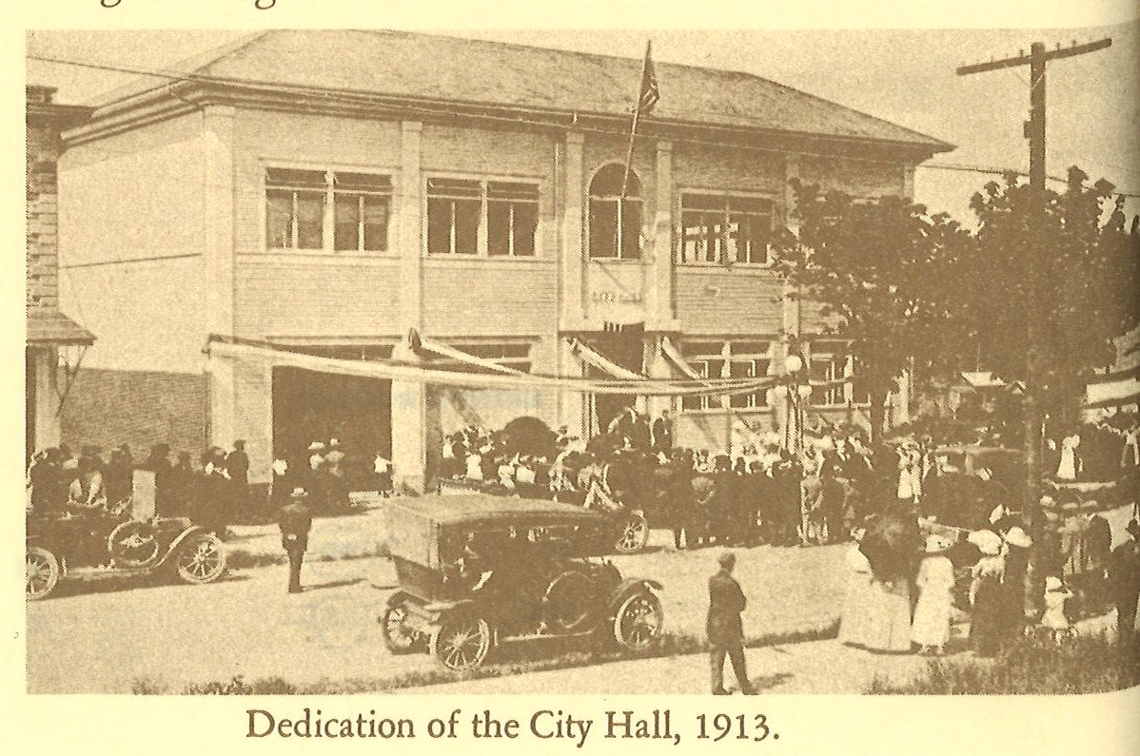
City of Carlton City Hall
City Hall and Fire Department Share a building.
1913
Pop.386

Slide 2
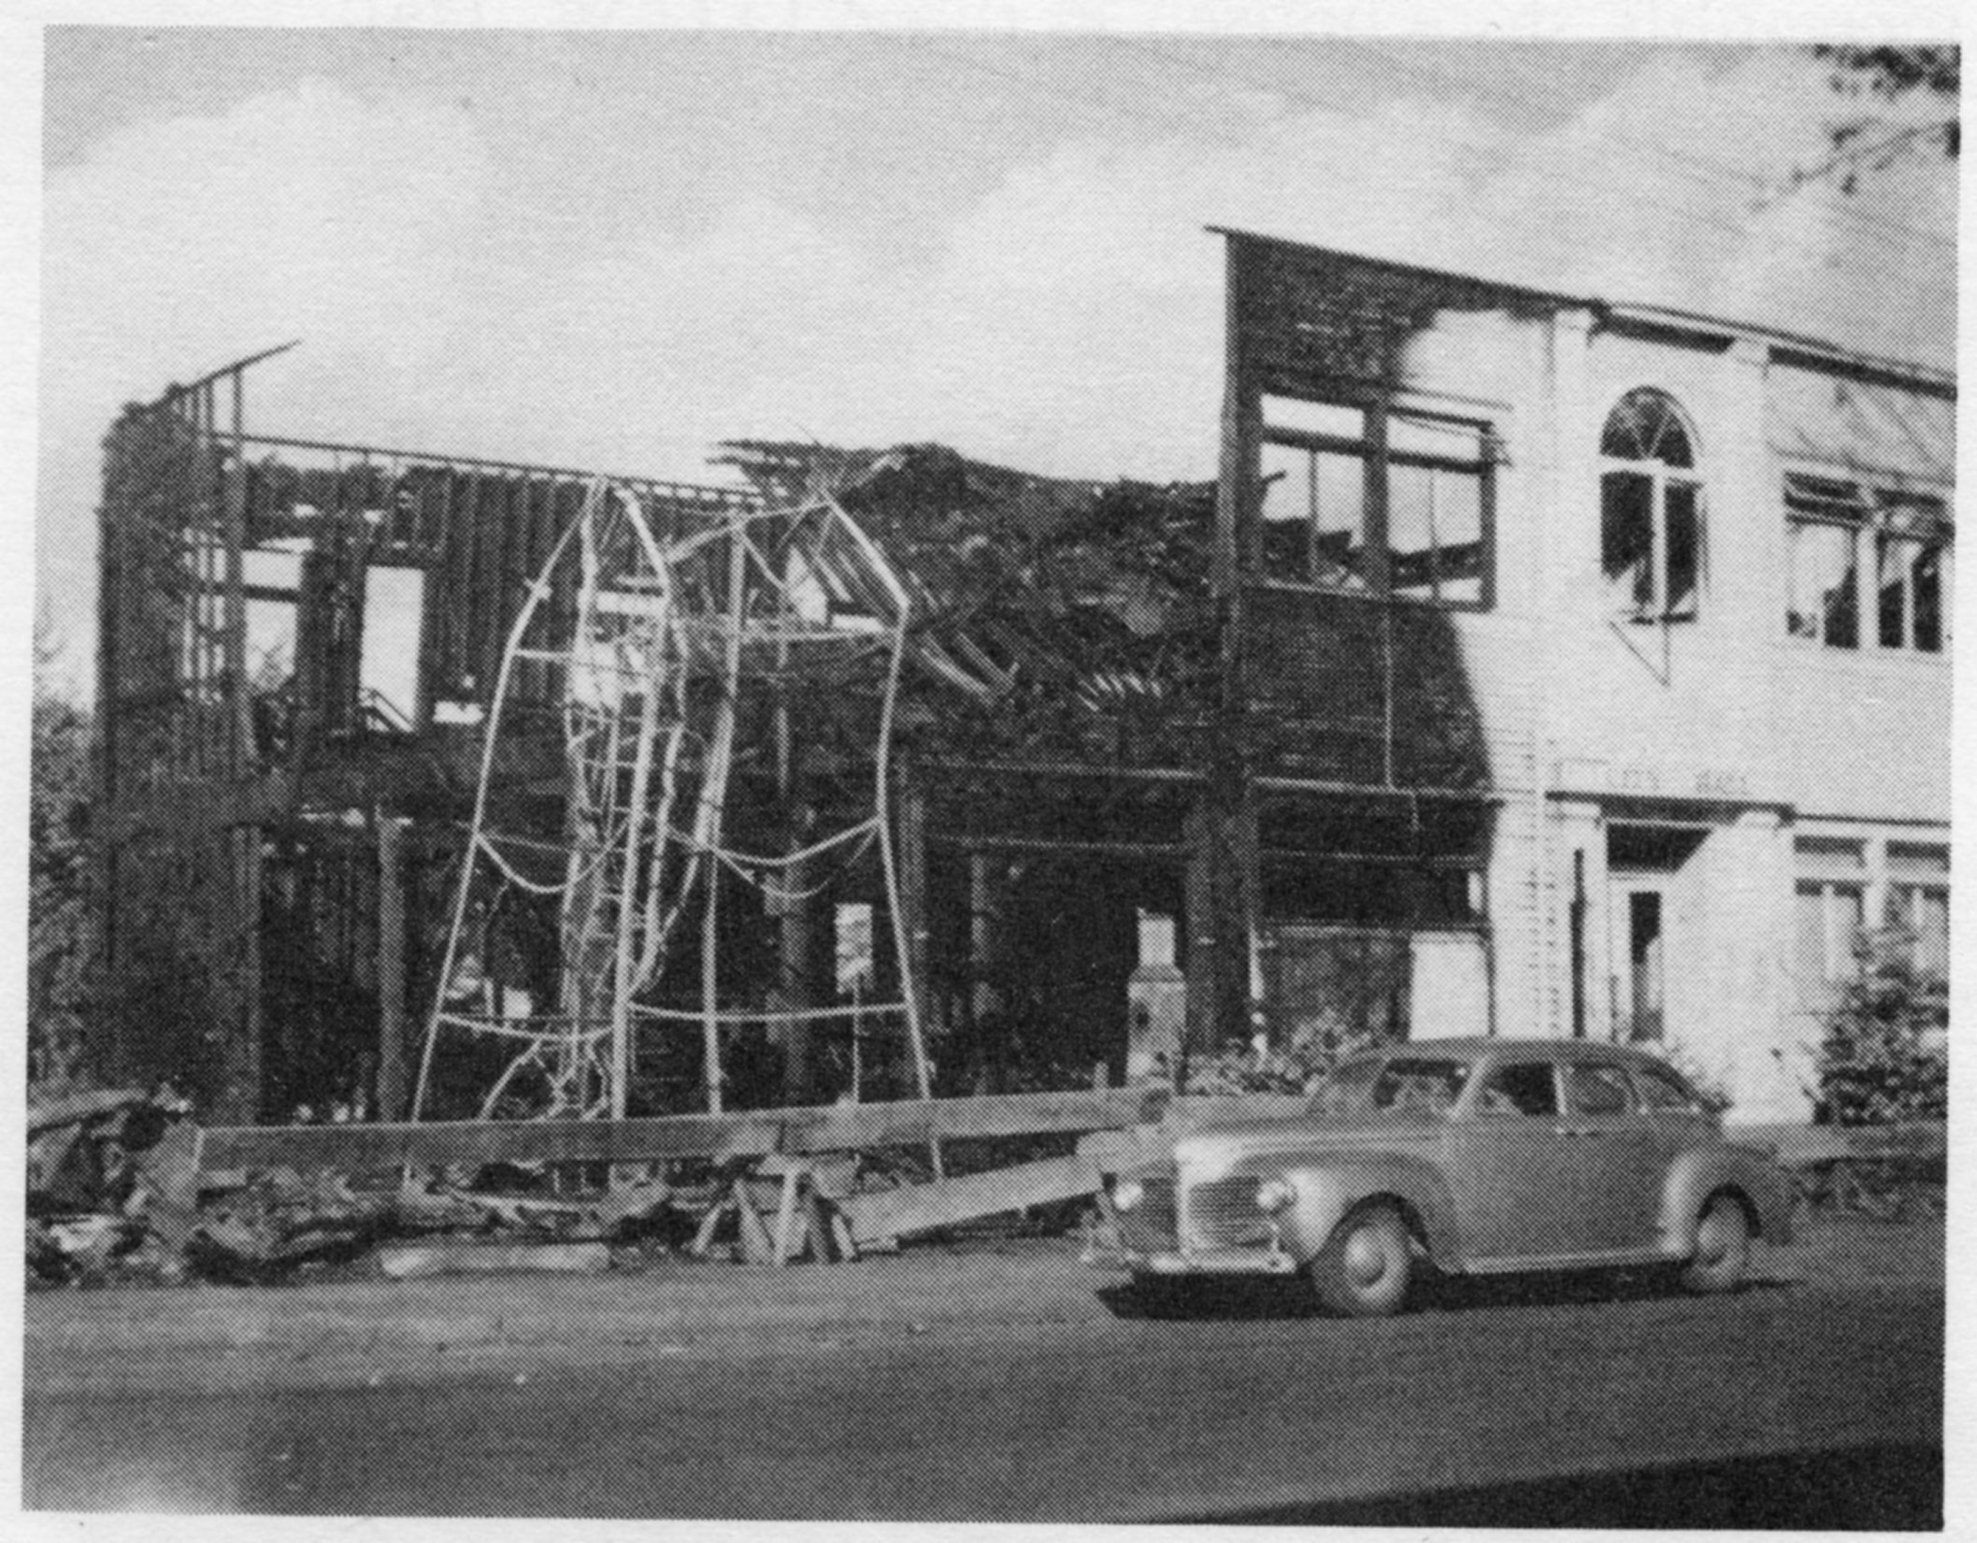
City of Carlton City Hall
1943-Share Building with Fire Department at the Old Fire Hall on Kutch Street.
1970-Move to the building on Pine and Main next to the theater-waiting for the new City Hall to be built in 1974.
Pop.864

Slide 3
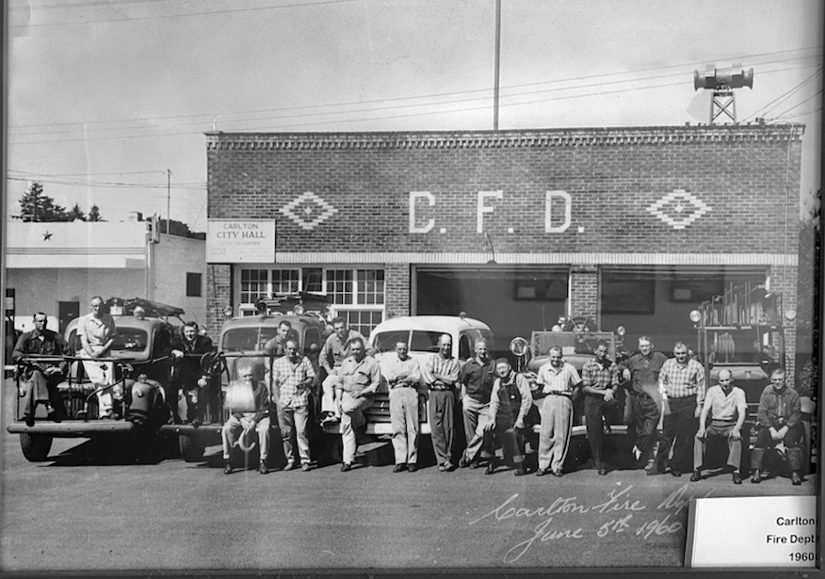
1960 City Hall Buildings
1913

Slide 4
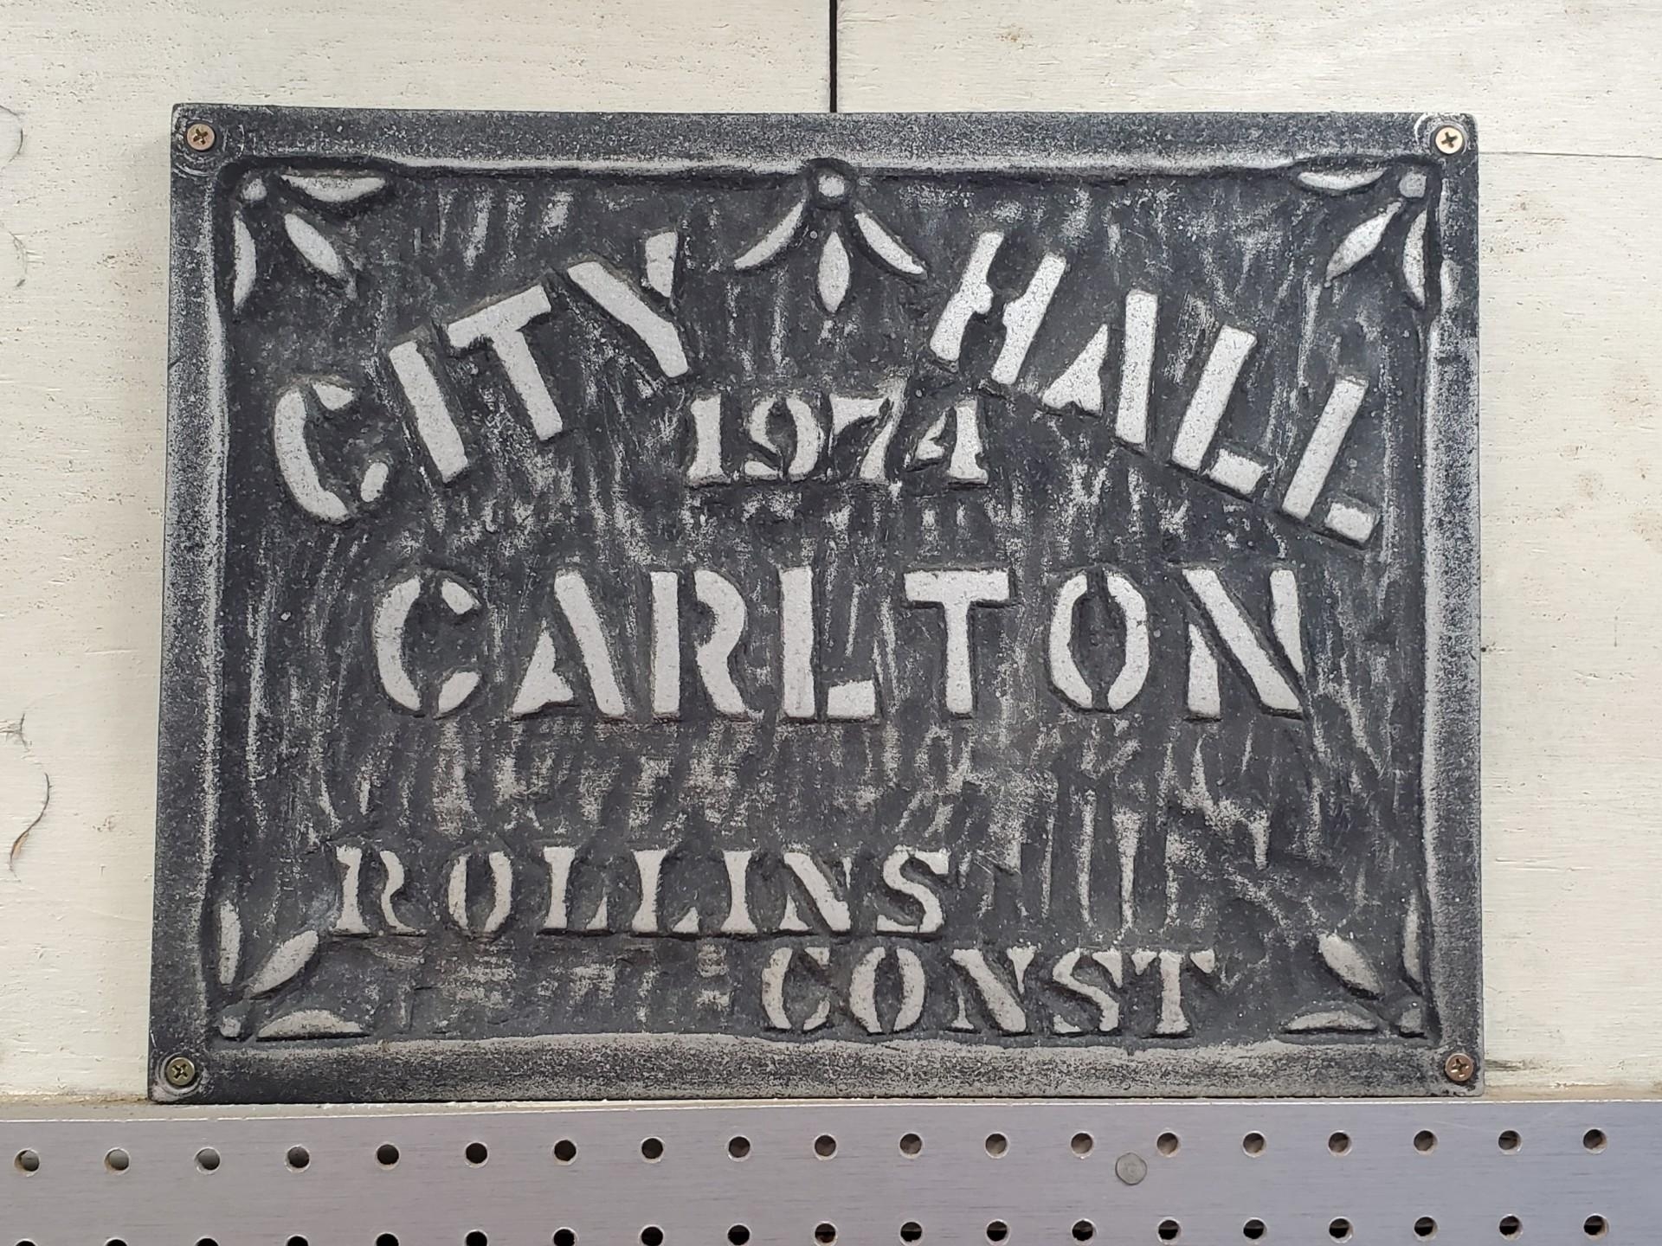
Current City Hall
Built in 1974: City Hall current age 47 years
POP. 1126

Slide 5
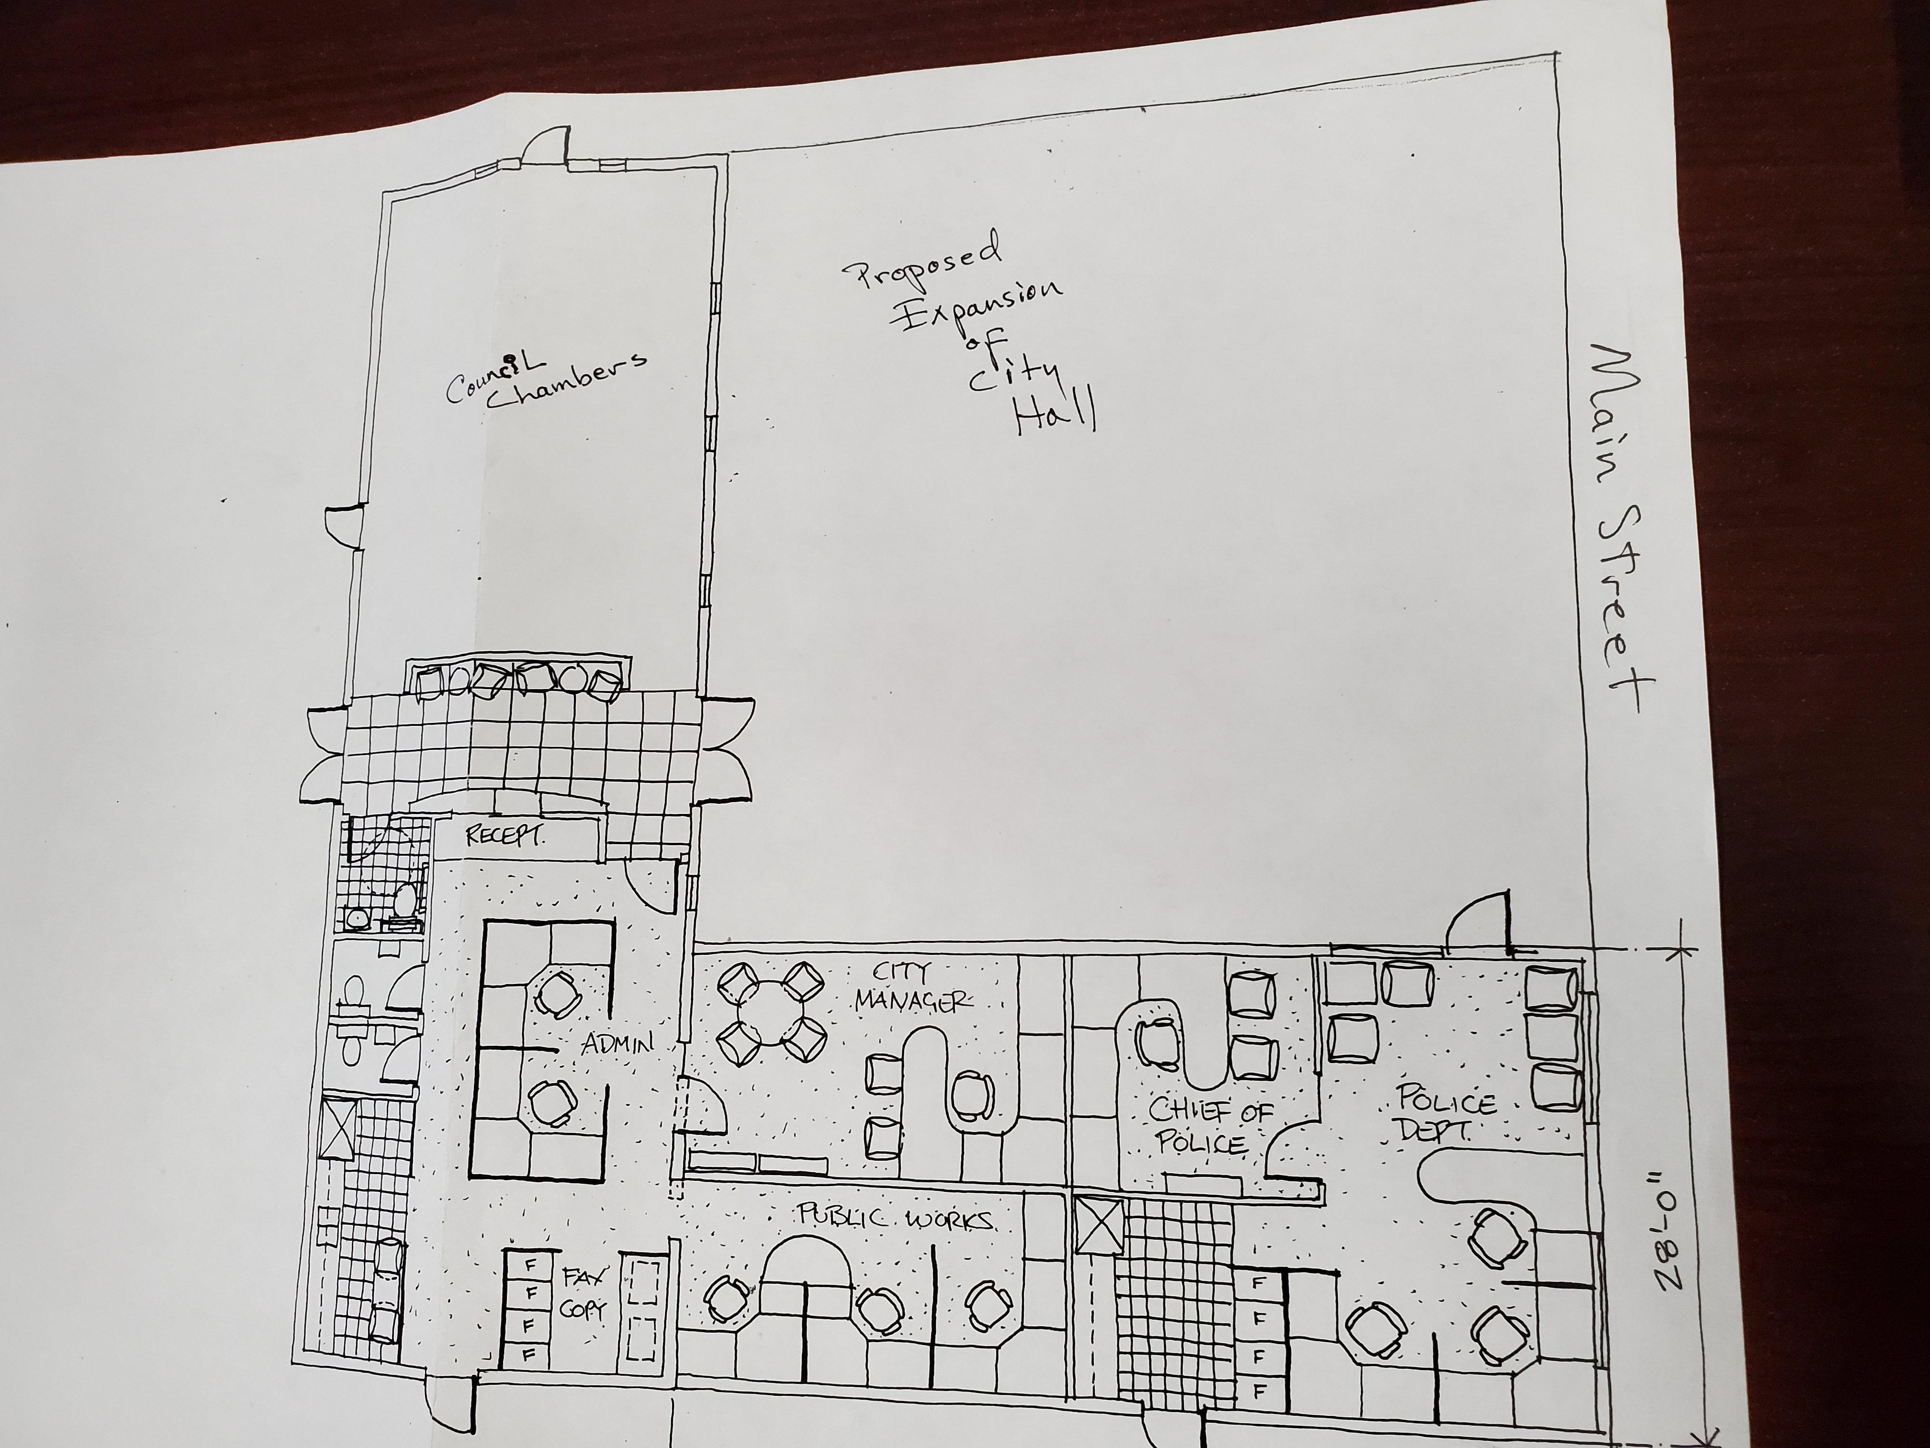
City of Carlton City Hall
Preliminary Drawing of an addition to City Hall drafted in 2003 at the direction of the Citizen groups request for a new City Hall.
Pop. 1514
Drawing went to LDC Engineers.
$10,000 Engineering costs incurred.
(No further action taken)

Slide 6
City Hall Citizen Engagement
FFA Architecture & Interiors hosted two town hall meetings for specific design feedback.
Citizen Ad-Hoc Committee was formed.
Tours provided for Community of City Hall.
George Fox-Enters the community, talking to community members, design takes shape.
George Fox, has citizens meeting in person to create community impressions on how the building should feel.

Slide 7
Carlton City Hall Citizen Participation
Pictured:
City Hall Advisory Committee
George Fox Students
Holst Architecture

Slide 8
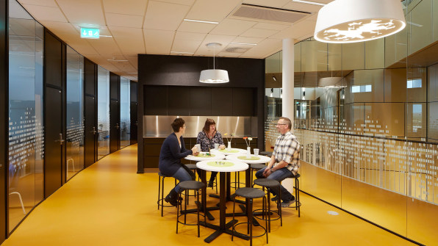
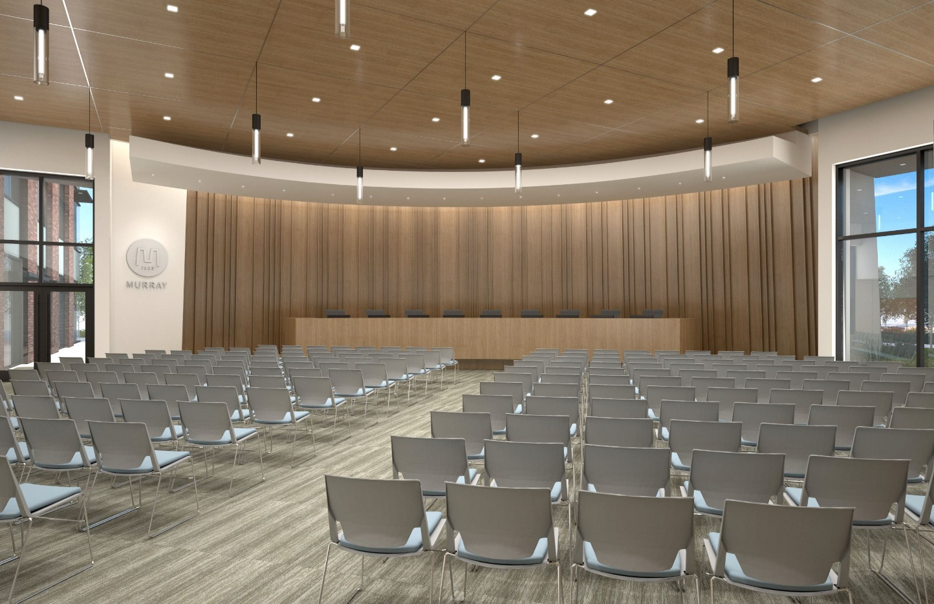
Community Benefits Proposed City Hall
Operational command center for major incidents and/or extreme weather storms that will allow City staff to respond to the citizens emergency needs efficiently and effectively with up-to-date equipment and facilities.
Emergency area for citizens to retreat to safety.
Has separate areas for victims and suspects minimize safety concerns for administrative staff and citizens.
Encourages citizen participation in Council meeting by having more room for our citizens.
Citizens can use the community room for meetings.
From floor to floor there are no barriers, the public will have access to everything except the offices and council chamber.
Council chambers will be available for public presentations and events.
City Hall is the first place citizens and visitors go to be directed to local activities and services
Is a catalyst for future economic development that potentially brings jobs and increased tax revenue to the City.
Mitigates City liability by allowing effective and timely response to citizens during emergency events.
Common sitting area for staff and citizens to meet and discuss city and community matters in a relaxed environment.

Slide 9
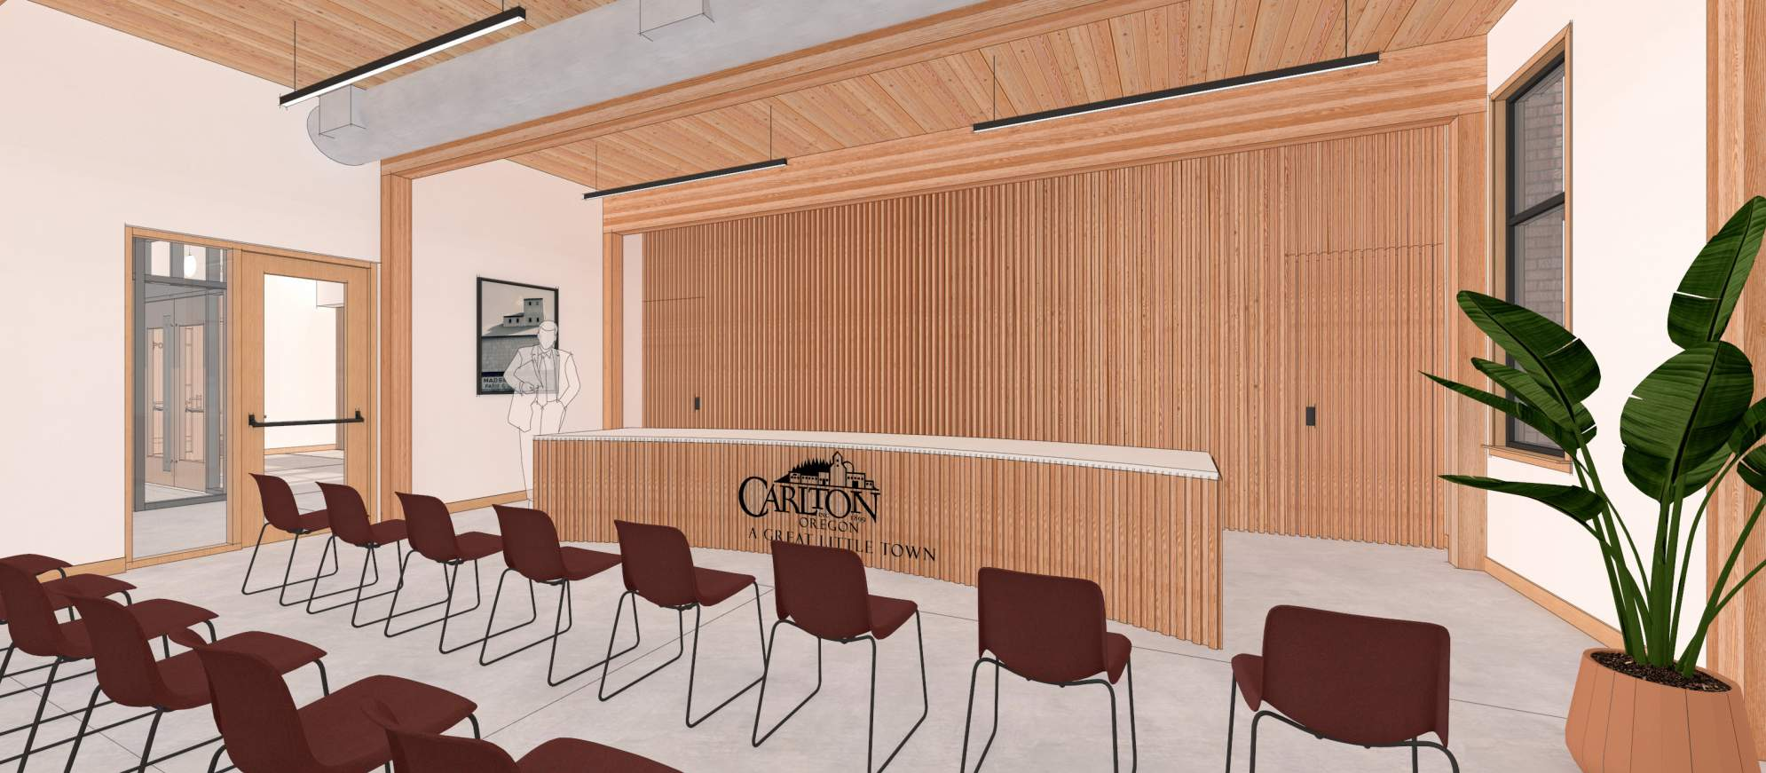
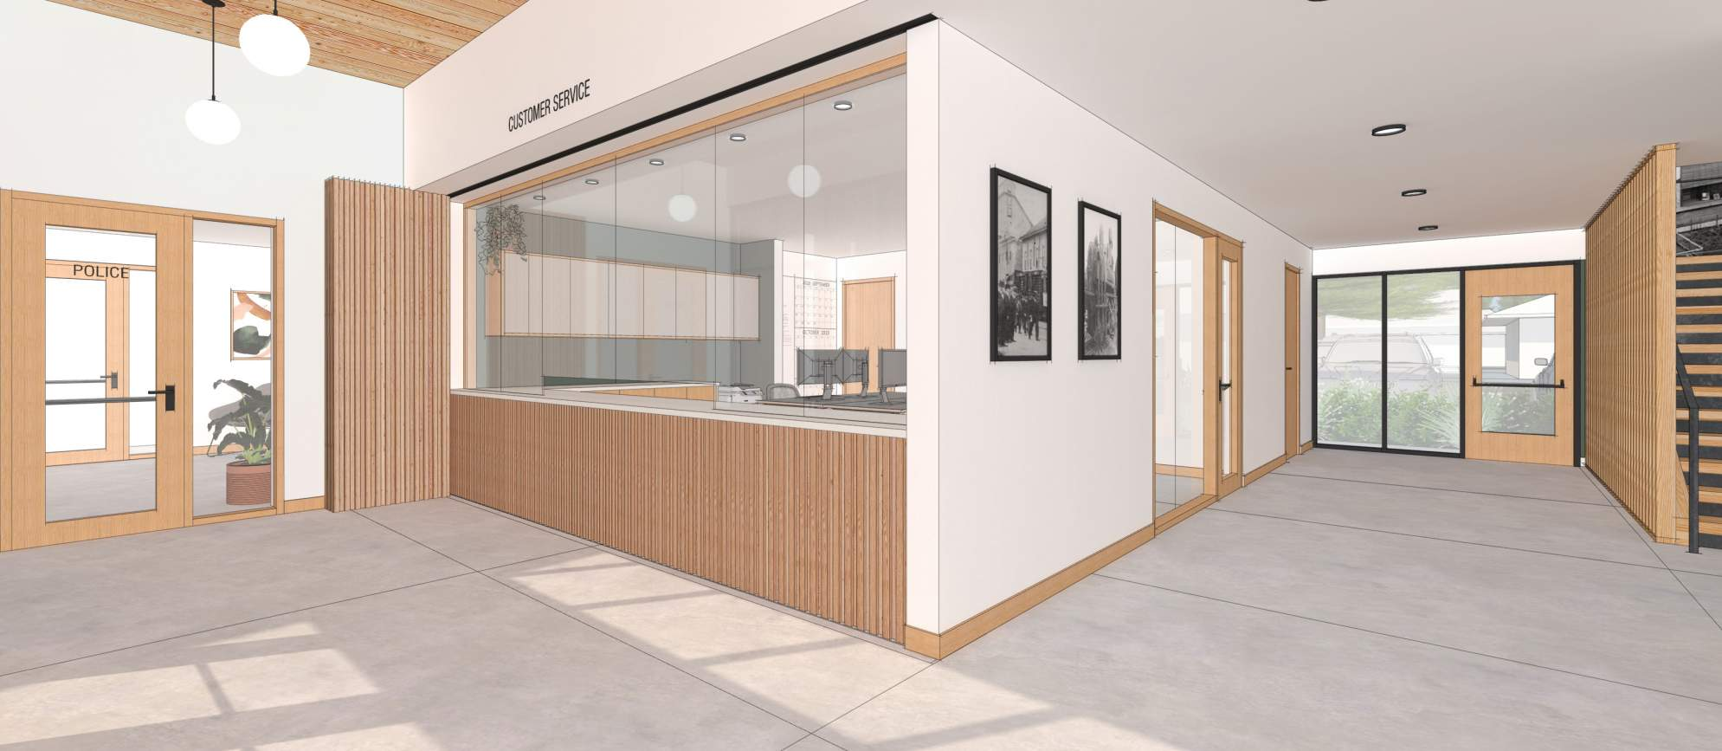
Community Benefits
Provides a public workstation area and charging station that a citizen can utilize if they need to fill out a form and/or use a computer to fill out forms, etc.
Restroom facilities for citizens.
Meets ADA compliance and other regulatory requirements that the City requires of other developments.
Mitigates City liability by optimizing employee safety in the workplace.
Operational efficiency gained from enhanced workspace.
Low interest rates now, deferral will drive up future interest rates and building costs.
Economy of scale related to City Hall and PD facilities addressed at the same time.
Energy efficiency and reduced costs.
Provides parking for public use and an alcove garden art area during and after business hours.

Slide 10
City Hall Timeline
2010-Council determines City Hall has security & safety issues from active bomb threat by individual entering city hall.
2011-Council determines “We have no more room” in City Hall.
2012 – Community Members and Council “Sight Seers” produce a community needs report calling for expansion of City Hall.
2012-City Manager and Council create funding plan for future City Hall.
2016-Council approved Marsia Mikesh Architecture to develop remodel/addition options-Remodel costs were too high-proceed with New City Hall possibility due to cost estimate of 1million for remodel.
2017-Council determines to go ahead with RFP and Citizens Advisory Committee-FFA Hired after RFP.
1912-New City Hall built.
1942-City Hall burns down.
1942-City Hall moves in with Fire Dept on Kutch Street.
1974-Construction of new City Hall
2003-LDC Design Group engineers plans for expansion of City Hall. City completes only a roof replacement.
2008-Council decides to try and extend life of the current temporary Police building due to collateral on the loan

Slide 11
City Hall Timeline
2018-Staff begins working with the George Fox students and community at-large on design for City Hall.
2019-Council determines to do RFP for an architect.
2019-Holst Architecture is hired.
2019 – Several public presentations to council and community.
2020-Geotchincal found that current building does not meet seismic code and will need a full rebuild.
2017-Citizens Advisory recommends bond for Public Safety side due to rising cost of construction. The City Hall portion has funds already dedicated for financing 3.5 mil. The bond recommendation came from the Citizen Ad-Hoc Committee after receiving the costs from FFA.
2018-The Bond for the Public Safety side of the building fails.
2018-FFA advises project cost increased from 6 mil to over 7 mil.

Slide 12
City Hall Financing
Commercial Building Loan Rates: 2016 4.25% 2019 3.51% 2021 2.24%
Expenditures to-date
Total= $388,892.28
Planning Fees, Architect,
Engineer, Survey, Attorney,
And Staff time.
May 2018 Election Results (Bond failed)
Citizens desired City Hall, but not extra taxes.
Measure 36-192 - City of Carlton (Public Safety Bond) 764 ballots (0 over voted ballots, 0 overvotes, 19 blank voted), 1505 registered voters, turnout 50.76%
(Total population approximately 2183)
Yes – 295 - 39.60%
No - 450 - 60.40%
745 total votes—Difference of 155 between Yes and No votes
760 registered voters that did not vote
Approx. 1,438 of Carlton's citizens did not vote
City Hall Funding Plan
Cash (1.3m) currently in the Capital
Improvement Fund in combination with a
Direct Obligation Loan
for remaining costs.
No tax increase
Annual Debt Payment programmed
in budget
since 2012 ($150k - $200k per year)
Lowest interest in 25 years
After Design is complete Grants
are available for seismic
and Command Center.

Slide 13
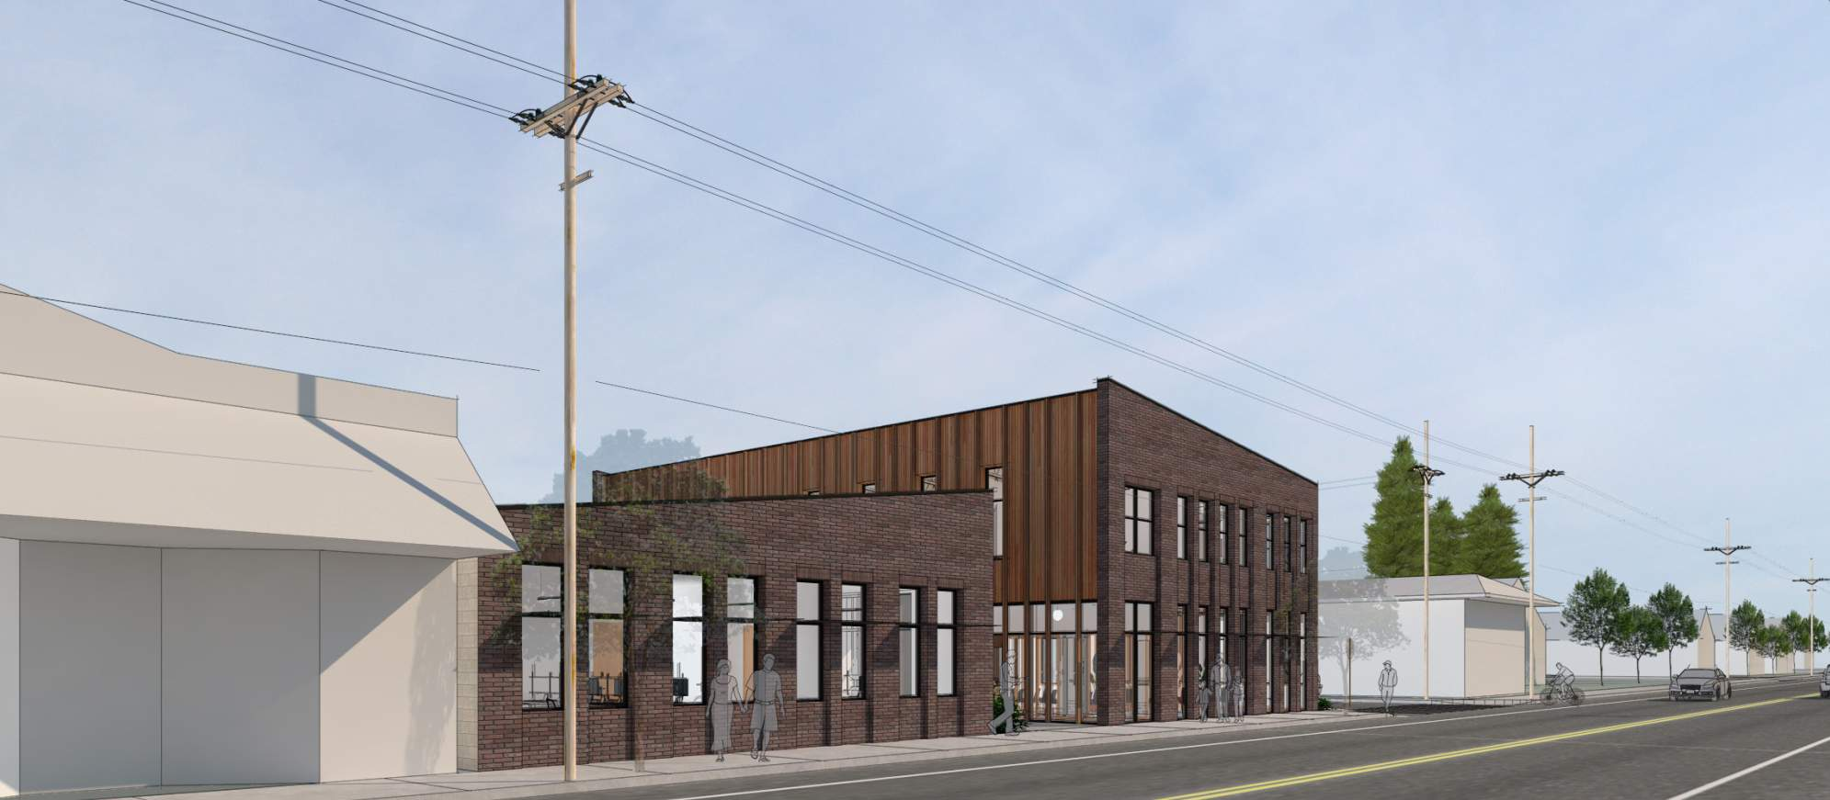
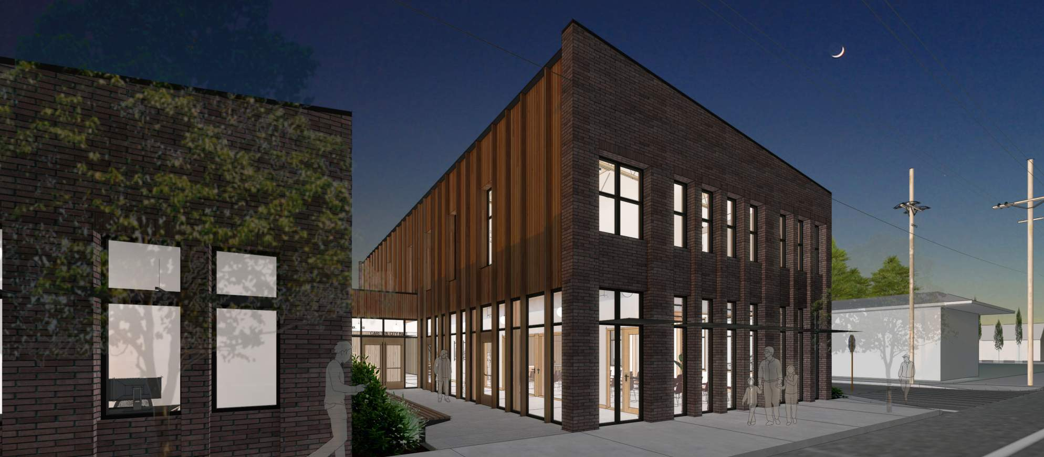
City Hall Build Comparators
City of Carlton Pool Building-$2m-3,500sq.
Hubbard-Pop.3475-$6m-14,890sq.
Florence-Pop.9329-$3m-11,500sq.
Monmouth-Pop.10282-$7m-15,000sq.
Silverton-Pop.10242-$18m-27,000sq.
Cannon Beach-Pop.1491-$22m-10,636sq.
Lowell-Pop.1196-$1.7m-5,005sq.
Design Ideas

Slide 14
Current City Hall Repair Needs
Inside wiring $32,000.
Generator for building $200,000.
HVAC system $150,000.
Roofing $50,000.
Remove trip and fall hazards for citizens. $175,000.
Painting exterior $8,000.
Parking Lot $200,000.
Buildings will not be able to sustain an earthquake.
**Figures base on rough estimates
All Yellow is trip hazard

